Slide 1
Using GPT with a Splitting Strategy for trainning
E-Da Hospital
Yung-Hsu Lei,MD
a89182a89182@gmail.com

Slide 2
Please download the file.
https://drive.google.com/file/d/1QzPfHdJ_FkRPz7TPaj_UvBkelUt9U4vB/view?usp=drive_link

Slide 3
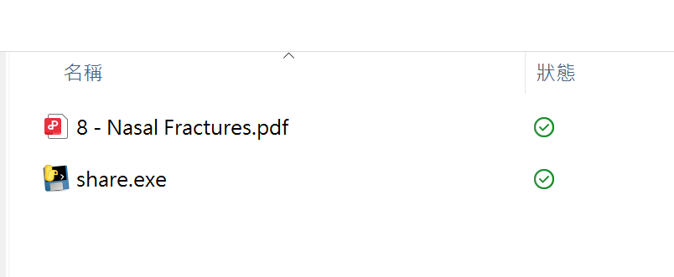
Place the target file in the same folder as the .exe file.

Slide 4
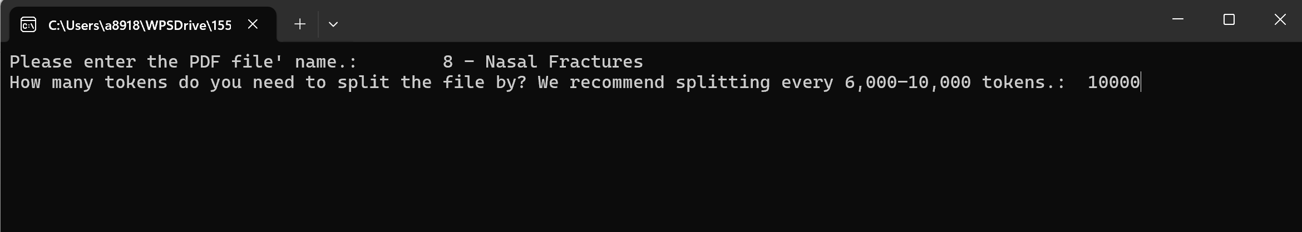
Open the .exe file and enter the file name

Slide 5
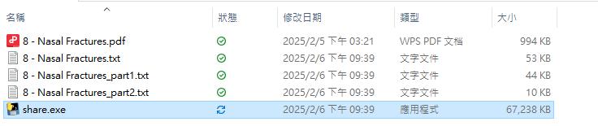
Output file.

Slide 6
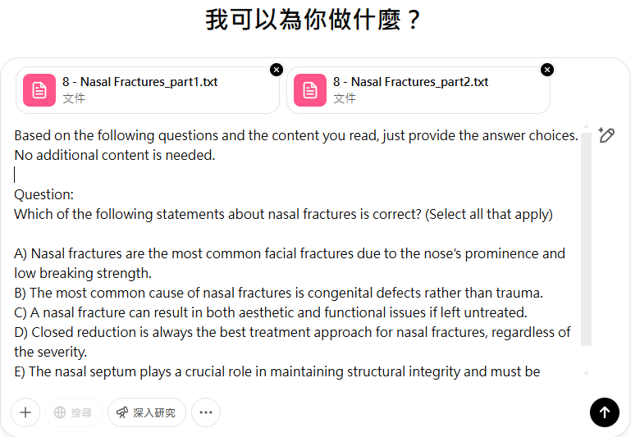
Enter the following prompt:

Slide 7
Using GPT with a Splitting Strategy for trainning
E-Da Hospital
Yung-Hsu Lei,MD
a89182a89182@gmail.com

